Slide 1

DEMO I.
Balogh Fanni Daniella
CANA BIFFLE - Grace-Hopper Group

Slide 2
INTRODUCTION
Who am I?
Past Studies
Actual Work
Why did I start this?

Slide 3
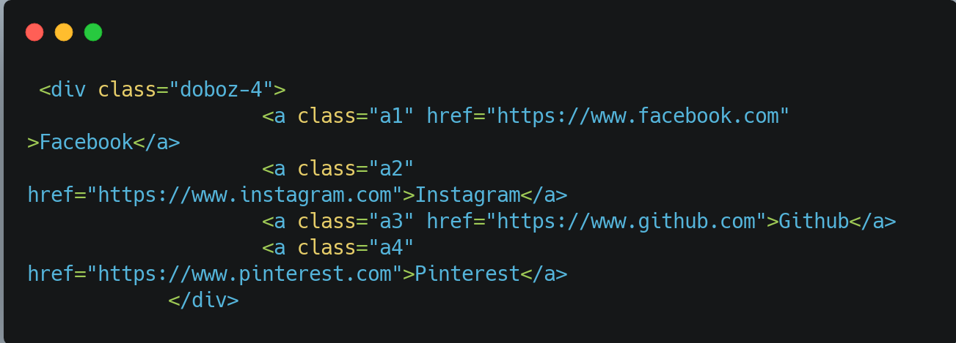

HTML

Slide 4
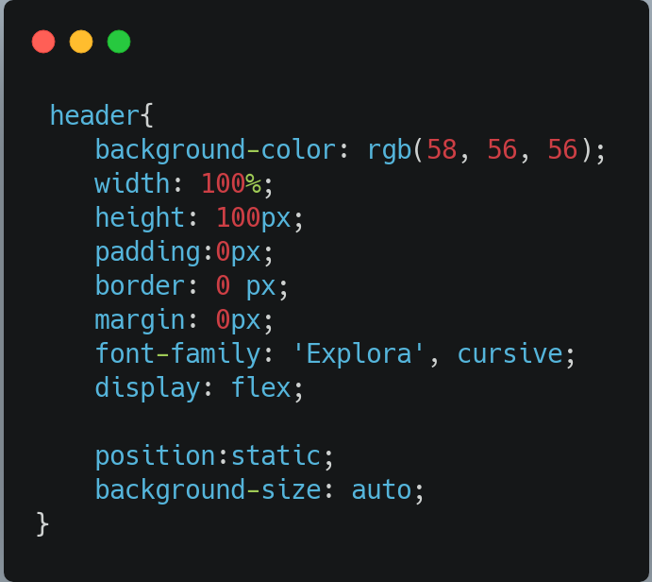

CSS

Slide 5
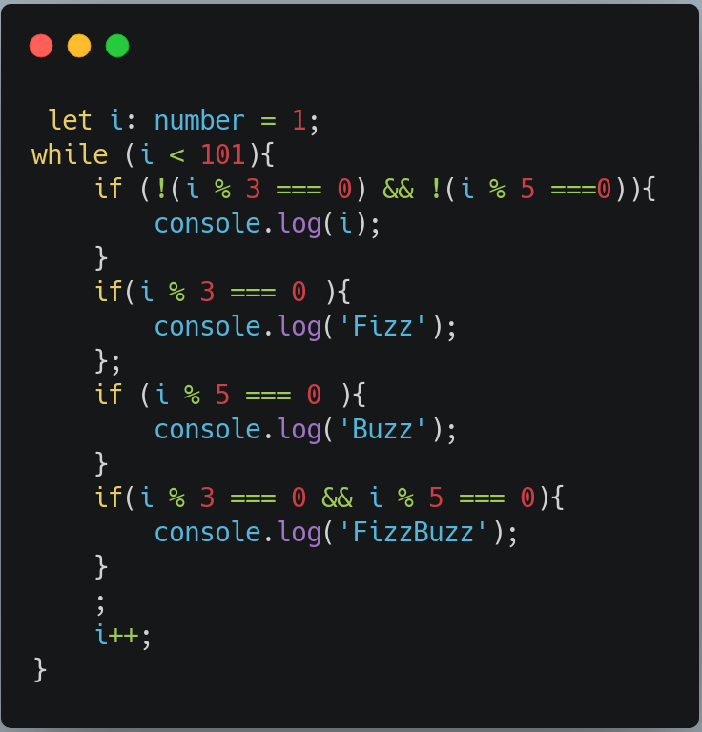
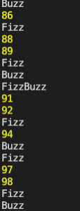
CONTROL FLOW

Slide 6
THANK YOU FOR YOUR ATTENTION!

